Slide 1
Introduction

Slide 2
Oracle is the Market Leader
Oracle is the preeminent data management platform in use throughout the world today
Microsoft consider #1 software maker in the world
Oracle is considered #2 (second largest) software maker in the world
However, MS SQL Server only runs on MS platforms, not Linux, Unix, or other platforms
IBM DB2 is a competitor
However 99 of top 100 revenue-generating web sites are built on the Oracle RDBMS

Slide 3
Oracle SQL vs ANSI SQL
Oracle SQL is close to, but not identical to, standard ANSI SQL (2003 standard)
ANSI
ISO

Slide 4

Oracle Database 11g: Focus Areas
Infrastructure
Grids
Information
Management
Application
Development
Notes:
Oracle Database 11g: SQL Fundamentals I I - <number>
Oracle Database 11g: Focus Areas
Oracle Database 11g offers extensive features across the following focus areas:
Infrastructure Grids: The Infrastructure Grid technology of Oracle enables pooling of low-cost servers and storage to form systems that deliver the highest quality of service in terms of manageability, high availability, and performance. Oracle Database 11g consolidates and extends the benefits of grid computing. Apart from taking full advantage of grid computing, Oracle Database 11g has unique change assurance features to manage changes in a controlled and cost effective manner.
Information Management: Oracle Database 11g extends the existing information management capabilities in content management, information integration, and information life cycle management areas. Oracle provides content management of advanced data types such as Extensible Markup Language (XML), text, spatial, multimedia, medical imaging, and semantic technologies.
Application Development: Oracle Database 11g has capabilities to use and manage all the major application development environments such as PL/SQL, Java/JDBC, .NET and Windows, PHP, SQL Developer, and Application Express.

Slide 5
Oracle Database 11g
Manageability
High availability
Performance
Security
Information integration
Notes:
Oracle Database 11g: SQL Fundamentals I I - <number>
Oracle Database 11g
Organizations need to support multiple terabytes of information for users who demand fast and secure access to business applications round-the-clock. The database systems must be reliable and must be able to recover quickly in the event of any kind of failure. Oracle Database 11g is designed along the following feature areas to help organizations manage infrastructure grids easily and deliver high-quality service:
Manageability: By using some of the change assurance, management automation, and fault diagnostics features, the database administrators (DBAs) can increase their productivity, reduce costs, minimize errors, and maximize quality of service. Some of the useful features that promote better management are Database Replay facility, the SQL Performance Analyzer, and the Automatic SQL Tuning facility.
High availability: By using the high availability features, you can reduce the risk of down time and data loss. These features improves online operations and enable faster database upgrades.

Slide 6
Oracle Database 11g
Manageability
High availability
Performance
Security
Information integration
Notes:
Oracle Database 11g: SQL Fundamentals I I - <number>
Oracle Database 11g (continued)
Performance: By using capabilities such as SecureFiles, compression for online transaction processing (OLTP), Real Application Clusters (RAC) optimizations, Result Caches and so on, you can greatly improve the performance of your database. Oracle Database 11g enables organizations to manage large, scalable transactional and data warehousing systems that deliver fast data access using low-cost modular storage.
Security: Oracle Database 11g helps organizations protect their information with unique secure configurations, data encryption and masking, and sophisticated auditing capabilities. It delivers a secure and scalable platform for reliable and fast access to all types of information by using the industry-standard interfaces.
Information integration: Oracle Database 11g has many features to better integrate data throughout the enterprise. It also supports advanced information life cycle management capabilities. This helps you manage the changing data in your database.

Slide 7
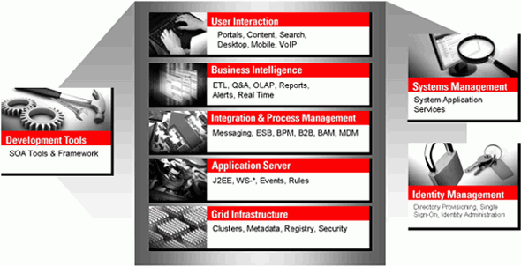
Oracle Fusion Middleware
Portfolio of leading, standards-based, and customer-proven software products that spans a range of tools and services from J2EE and developer tools, through integration services, business intelligence, collaboration, and content management
Notes:
Oracle Database 11g: SQL Fundamentals I I - <number>
Oracle Fusion Middleware
Oracle Fusion Middleware is a comprehensive and well-integrated family of products that offers complete support for development, deployment, and management of Service-Oriented Architecture (SOA). SOA facilitates the development of modular business services that can be easily integrated and reused, thereby reducing development and maintenance costs, and providing higher quality of services. Oracle Fusion Middleware’s pluggable architecture enables you to leverage your investments in any existing application, system, or technology. Its unbreakable core technology minimizes the disruption caused by planned or unplanned outages.
Some of the products from the Oracle Fusion Middleware family include:
Enterprise Application Server: Application Server
Integration and Process Management: BPEL Process Manager, Oracle Business Process Analysis Suite
Development Tools: Oracle Application Development Framework, JDeveloper, SOA Suite
Business Intelligence: Oracle Business Activity Monitoring, Oracle Data Integrator
Systems Management: Enterprise Manager
Identity Management: Oracle Identity Management
Content Management: Oracle Content Database Suite
User Interaction: Portal, WebCenter

Slide 8

Oracle Enterprise Manager Grid Control 10g
  database administration and application management tool
Notes:
Oracle Database 11g: SQL Fundamentals I I - <number>
Oracle Enterprise Manager Grid Control 10g
Spanning applications, middleware, and database management, Oracle Enterprise Manager Grid Control 10g delivers integrated enterprise management for Oracle and non-Oracle systems.
Oracle Enterprise Manager Grid Control 10g features advanced Oracle Fusion Middleware management capabilities for the services that business applications rely upon, including SOA, Business Activity Monitoring, and Identity Management.
Wide-ranging management functionality for your applications including service-level management, application performance management, configuration management, and change automation
Built-in grid automation capabilities means that information technology responds proactively to fluctuating demand and implements new services more quickly so that businesses can thrive.
In-depth diagnostics and readily available remediation across a range of applications including custom-built applications, Oracle E-Business Suite, PeopleSoft, Siebel, Oracle Fusion Middleware, Oracle Database, and underlying infrastructure
Extensive life cycle management capabilities extends grid computing by providing solutions for the entire application and infrastructure life cycle, including test, stage, and production through operations. It has simplified patch management with synchronized patching, additional operating system support, and conflict detection features.

Slide 9


Oracle BI Publisher
  Provides a central architecture for authoring, managing, and delivering information in secure and multiple formats
  Reduces complexity and time to develop, test, and deploy all kinds of reports
    Financial Reports, Invoices, Sales or Purchase orders, XML, and EDI/EFT(eText documents)
  Enables flexible customizations
    For example, a Microsoft Word document report can be generated in multiple formats such as PDF, HTML, Excel, RTF, and so on.
PDF
HTML
BI PUBLISHER
Microsoft Word
Excel
Notes:
Oracle Database 11g: SQL Fundamentals I I - <number>
Oracle BI Publisher
Oracle Database 11g also includes Oracle BI Publisher—the enterprise reporting solution from Oracle. Oracle BI Publisher (formerly known as XML Publisher) offers the most efficient and scalable reporting solution available for complex, distributed environments.
Oracle BI Publisher reduces the high costs associated with the development, customization, and maintenance of business documents, while increasing the efficiency of reports management. By using a set of familiar desktop tools, users can create and maintain their own report formats based on data queries created by the IT staff or developers.
Oracle BI Publisher report formats can be designed using Microsoft Word or Adobe Acrobat—tools that most users are already familiar with. Oracle BI Publisher also enables you to bring in data from multiple data sources into a single output document. You can deliver reports via printer, email, or fax. You can publish your report to a portal. You can even allow users to collaboratively edit and manage reports on the Web-based Distributed Authoring and Versioning (WebDav) Web servers.

Slide 10
Lesson Agenda
  Course objectives, course agenda, and appendixes used in this course
  Overview of Oracle Database 11g and related products
  Overview of relational database management concepts and terminologies
  Introduction to SQL and its development environments
  The HR schema and the tables used in this course
  Oracle Database 11g documentation and additional resources
Notes:
Oracle Database 11g: SQL Fundamentals I I - <number>

Slide 11
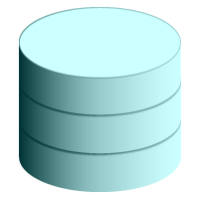

Relational and Object Relational
Database Management Systems
  Relational model and object relational model
  User-defined data types and objects
  Fully compatible with relational database
  Supports multimedia and large objects
  High-quality database server features
Notes:
Oracle Database 11g: SQL Fundamentals I I - <number>
Relational and Object Relational Database Management Systems
The Oracle server supports both the relational and the object relational database models.
The Oracle server extends the data-modeling capabilities to support an object relational database model that provides object-oriented programming, complex data types, complex business objects, and full compatibility with the relational world.
It includes several features for improved performance and functionality of the OLTP applications, such as better sharing of run-time data structures, larger buffer caches, and deferrable constraints. Data warehouse applications benefit from enhancements such as parallel execution of insert, update, and delete operations; partitioning; and parallel-aware query optimization. The Oracle model supports client/server and Web-based applications that are distributed and multitiered.
For more information about the relational and object relational model, see the Oracle Database Concepts 11g Release 1 (11.1) manual.

Slide 12
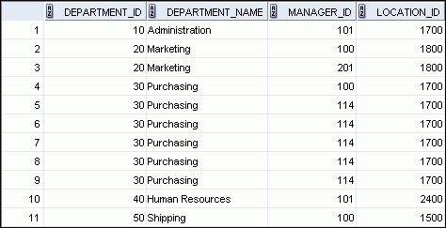
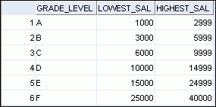



Data Storage on Different Media
Electronic spreadsheet
Filing cabinet
Database
Notes:
Oracle Database 11g: SQL Fundamentals I I - <number>
Data Storage on Different Media
Every organization has some information needs. A library keeps a list of members, books, due dates, and fines. A company needs to save information about its employees, departments, and salaries. These pieces of information are called data.
Organizations can store data in various media and in different formats, such as a hard copy document in a filing cabinet, or data stored in electronic spreadsheets, or in databases.
A database is an organized collection of information.
To manage databases, you need a database management system (DBMS). A DBMS is a program that stores, retrieves, and modifies data in databases on request. There are four main types of databases: hierarchical, network, relational, and (most recently) object relational.

Slide 13
Relational Database Concept
  Dr. E. F. Codd proposed the relational model for database systems in 1970.
  It is the basis for the relational database management system (RDBMS).
  The relational model consists of the following:
    Collection of objects or relations
    Set of operators to act on the relations
    Data integrity for accuracy and consistency
Notes:
Oracle Database 11g: SQL Fundamentals I I - <number>
Relational Database Concept
The principles of the relational model were first outlined by Dr. E. F. Codd in a June 1970 paper titled “A Relational Model of Data for Large Shared Data Banks.” In this paper, Dr. Codd proposed the relational model for database systems.
The common models used at that time were hierarchical and network, or even simple flat-file data structures. Relational database management systems (RDBMS) soon became very popular, especially for their ease of use and flexibility in structure. In addition, a number of innovative vendors, such as Oracle, supplemented the RDBMS with a suite of powerful, application development and user-interface products, thereby providing a total solution.
Components of the Relational Model
Collections of objects or relations that store the data
A set of operators that can act on the relations to produce other relations
Data integrity for accuracy and consistency
For more information, see An Introduction to Database Systems, Eighth Edition (Addison-Wesley: 2004), written by Chris Date.

Slide 14


Definition of a Relational Database
A relational database is a collection of relations or
two-dimensional tables.
Oracle
server
Table name: EMPLOYEES
Table name: DEPARTMENTS
…
…
Notes:
Oracle Database 11g: SQL Fundamentals I I - <number>
Definition of a Relational Database
A relational database uses relations or two-dimensional tables to store information.
For example, you might want to store information about all the employees in your company. In a relational database, you create several tables to store different pieces of information about your employees, such as an employee table, a department table, and a salary table.

Slide 15


Data Models
Model of
system
in client’s
mind
Entity model of
client’s model
Table model
of entity model
Oracle
server
Tables on disk
Notes:
Oracle Database 11g: SQL Fundamentals I I - <number>
Data Models
Models are the cornerstone of design. Engineers build a model of a car to work out any details before putting it into production. In the same manner, system designers develop models to explore ideas and improve the understanding of database design.
Purpose of Models
Models help communicate the concepts that are in people’s minds. They can be used to do the following:
Communicate
Categorize
Describe
Specify
Investigate
Evolve
Analyze
Imitate
The objective is to produce a model that fits a multitude of these uses, can be understood by an end user, and contains sufficient detail for a developer to build a database system.

Slide 16
Entity Relationship Model
  Create an entity relationship diagram from business specifications or narratives:
  Scenario:
    “. . . Assign one or more employees to a
    department . . .”
    “. . . Some departments do not yet have assigned employees
    . . .”
EMPLOYEE
#* number
* name
o job title
DEPARTMENT
#* number
* name
o location
assigned to
composed of
Notes:
Oracle Database 11g: SQL Fundamentals I I - <number>
Entity Relationship Model
In an effective system, data is divided into discrete categories or entities. An entity relationship (ER) model is an illustration of the various entities in a business and the relationships among them. An ER model is derived from business specifications or narratives and built during the analysis phase of the system development life cycle. ER models separate the information required by a business from the activities performed within the business. Although businesses can change their activities, the type of information tends to remain constant. Therefore, the data structures also tend to be constant.

Slide 17
Notes:
Oracle Database 11g: SQL Fundamentals I I - <number>
Entity Relationship Model (continued)
Benefits of ER Modeling:
Documents information for the organization in a clear, precise format
Provides a clear picture of the scope of the information requirement
Provides an easily understood pictorial map for database design
Offers an effective framework for integrating multiple applications
Key Components
Entity: An aspect of significance about which information must be known. Examples are departments, employees, and orders.
Attribute: Something that describes or qualifies an entity. For example, for the employee entity, the attributes would be the employee number, name, job title, hire date, department number, and so on. Each of the attributes is either required or optional. This state is called optionality.
Relationship: A named association between entities showing optionality and degree. Examples are employees and departments, and orders and items

Slide 18
Entity Relationship
Modeling Conventions
Entity:
  Singular, unique name
  Uppercase
  Soft box
  Synonym in parentheses
Attribute:
  Singular name
  Lowercase
  Mandatory marked with “*”
  Optional marked with “o”
EMPLOYEE
#* number
* name
o job title
DEPARTMENT
#* number
* name
o location
assigned to
composed of
Unique Identifier (UID)
Primary marked with “#”
Secondary marked with “(#)”
Notes:
Oracle Database 11g: SQL Fundamentals I I - <number>
ER Modeling Conventions
Entities
To represent an entity in a model, use the following conventions:
Singular, unique entity name
Entity name in uppercase
Soft box
Optional synonym names in uppercase within parentheses: ( )
Attributes
To represent an attribute in a model, use the following conventions:
Singular name in lowercase
Asterisk (*) tag for mandatory attributes (that is, values that must be known)
Letter “o” tag for optional attributes (that is, values that may be known)
Relationships

Slide 19
Notes:
Oracle Database 11g: SQL Fundamentals I I - <number>
ER Modeling Conventions (continued)
Relationships
Each direction of the relationship contains:
A label: for example, taught by or assigned to
An optionality: either must be or maybe
A degree: either one and only one or one or more
Note: The term cardinality is a synonym for the term degree.
Each source entity {may be | must be} in relation {one and only one | one or more} with the destination entity.
Note: The convention is to read clockwise.
Unique Identifiers
A unique identifier (UID) is any combination of attributes or relationships, or both, that serves to distinguish occurrences of an entity. Each entity occurrence must be uniquely identifiable.
Tag each attribute that is part of the UID with a hash sign “#”.
Tag secondary UIDs with a hash sign in parentheses (#).

Slide 20
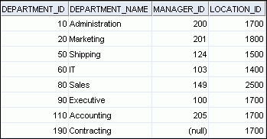
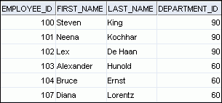
Relating Multiple Tables
  Each row of data in a table is uniquely identified by a primary key.
  You can logically relate data from multiple tables using foreign keys.
Table name: DEPARTMENTS
Table name: EMPLOYEES
…
Primary key
Foreign key
Primary key
Notes:
Oracle Database 11g: SQL Fundamentals I I - <number>
Relating Multiple Tables
Each table contains data that describes exactly one entity. For example, the EMPLOYEES table contains information about employees. Categories of data are listed across the top of each table, and individual cases are listed below. By using a table format, you can readily visualize, understand, and use information.
Because data about different entities is stored in different tables, you may need to combine two or more tables to answer a particular question. For example, you may want to know the location of the department where an employee works. In this scenario, you need information from the EMPLOYEES table (which contains data about employees) and the DEPARTMENTS table (which contains information about departments). With an RDBMS, you can relate the data in one table to the data in another by using the foreign keys. A foreign key is a column (or a set of columns) that refers to a primary key in the same table or another table.
You can use the ability to relate data in one table to data in another to organize information in separate, manageable units. Employee data can be kept logically distinct from the department data by storing it in a separate table.

Slide 21
Notes:
Oracle Database 11g: SQL Fundamentals I I - <number>
Relating Multiple Tables (continued)
Guidelines for Primary Keys and Foreign Keys
You cannot use duplicate values in a primary key.
Primary keys generally cannot be changed.
Foreign keys are based on data values and are purely logical (not physical) pointers.
A foreign key value must match an existing primary key value or unique key value, otherwise it must be null.
A foreign key must reference either a primary key or a unique key column.

Slide 22
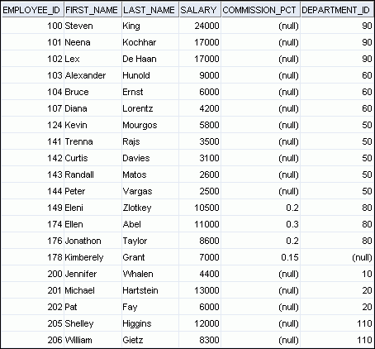
Relational Database Terminology
3
2
4
5
6
1
Notes:
Oracle Database 11g: SQL Fundamentals I I - <number>
Relational Database Terminology
A relational database can contain one or many tables. A table is the basic storage structure of an RDBMS. A table holds all the data necessary about something in the real world, such as employees, invoices, or customers.
The slide shows the contents of the EMPLOYEES table or relation. The numbers indicate the following:
1. A single row (or tuple) representing all the data required for a particular employee. Each row in a table should be identified by a primary key, which permits no duplicate rows. The order of rows is insignificant; specify the row order when the data is retrieved.
2. A column or attribute containing the employee number. The employee number identifies a unique employee in the EMPLOYEES table. In this example, the employee number column is designated as the primary key. A primary key must contain a value and the value must be unique.
3. A column that is not a key value. A column represents one kind of data in a table; in this example, the data is the salaries of all the employees. Column order is insignificant when storing data; specify the column order when the data is retrieved.

Slide 23
Notes:
Oracle Database 11g: SQL Fundamentals I I - <number>
Relational Database Terminology (continued)
4. A column containing the department number, which is also a foreign key. A foreign key is a column that defines how tables relate to each other. A foreign key refers to a primary key or a unique key in the same table or in another table. In the example, DEPARTMENT_ID uniquely identifies a department in the DEPARTMENTS table.
5. A field can be found at the intersection of a row and a column. There can be only one value in it.
6. A field may have no value in it. This is called a null value. In the EMPLOYEES table, only those employees who have the role of sales representative have a value in the COMMISSION_PCT (commission) field.

Slide 24
Lesson Agenda
  Course objectives, course agenda, and appendixes used in this course
  Overview of Oracle Database 11g and related products
  Overview of relational database management concepts and terminologies
  Introduction to SQL and its development environments
  The HR schema and the tables used in this course
  Oracle Database 11g documentation and additional resources
Notes:
Oracle Database 11g: SQL Fundamentals I I - <number>

Slide 25
Generations of Languages
SQL is most widely used, and most successful 4GL
Generations of languages:
  1GL -- machine code
  2GL – assembly language
  3GL – procedural languages (Java, C#, PHP, etc.)
  4GL – programmer doesn’t have to give the procedure, closer to human language
    SQL
    Artificial intelligence languages

Slide 26
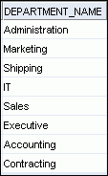
Using SQL to Query Your Database
Structured query language (SQL) is:
  The ANSI standard language for operating relational databases
  Efficient, easy to learn, and use
  Functionally complete (With SQL, you can define, retrieve, and manipulate data in the tables.)
SELECT department_name
FROM departments;
Oracle
server
Notes:
Oracle Database 11g: SQL Fundamentals I I - <number>
Using SQL to Query Your Database
In a relational database, you do not specify the access route to the tables, and you do not need to know how the data is arranged physically.
To access the database, you execute a structured query language (SQL) statement, which is the American National Standards Institute (ANSI) standard language for operating relational databases. SQL is a set of statements with which all programs and users access data in an Oracle database. Application programs and Oracle tools often allow users access to the database without using SQL directly, but these applications, in turn, must use SQL when executing the user’s request.
SQL provides statements for a variety of tasks, including:
Querying data
Inserting, updating, and deleting rows in a table
Creating, replacing, altering, and dropping objects
Controlling access to the database and its objects
Guaranteeing database consistency and integrity
SQL unifies all of the preceding tasks in one consistent language and enables you to work with data at a logical level.

Slide 27
SQL Statements
SELECT
INSERT
UPDATE
DELETE
MERGE
CREATE
ALTER
DROP
RENAME
TRUNCATE
COMMENT
GRANT
REVOKE
COMMIT
ROLLBACK
SAVEPOINT
Data manipulation language (DML)
Data definition language (DDL)
Data control language (DCL)
Transaction control
Notes:
Oracle Database 11g: SQL Fundamentals I I - <number>
SQL Statements
SQL statements supported by Oracle comply with industry standards. Oracle Corporation ensures future compliance with evolving standards by actively involving key personnel in SQL standards committees. The industry-accepted committees are ANSI and International Standards Organization (ISO). Both ANSI and ISO have accepted SQL as the standard language for relational databases.

Slide 28
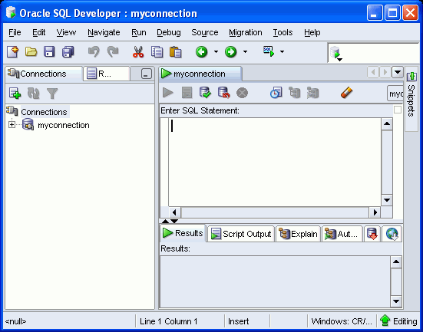
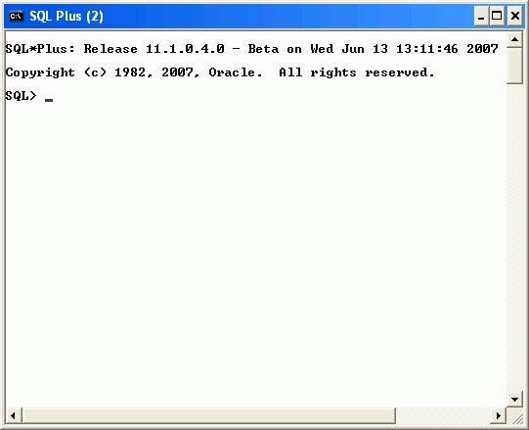
Development Environments for SQL
There are two development environments for this course:
  Primary tool is Oracle SQL Developer
  SQL*Plus command line interface may also be used
SQL Developer
SQL *Plus
Notes:
Oracle Database 11g: SQL Fundamentals I I - <number>
Development Environments for SQL
SQL Developer
This course has been developed using Oracle SQL Developer as the tool for running the SQL statements discussed in the examples in the slide and the practices.
SQL Developer version 1.2 is shipped with Oracle Database 11g, and is the default tool for this class.
In addition, SQL Developer version 1.5.3 is also available on the classroom machine, and may be installed for use. At the time of publication for this course, version 1.5.3 was the latest release of SQL Developer.
SQL*Plus
The SQL*Plus environment may also be used to run all SQL commands covered in this course.
Note
See Appendix E for information on using SQL Developer, including simple instructions on installing version 1.5.3.
See Appendix D for information on using SQL*Plus.

Slide 29
Lesson Agenda
  Course objectives, course agenda, and appendixes used in this course
  Overview of Oracle Database 11g and related products
  Overview of relational database management concepts and terminologies
  Introduction to SQL and its development environments
  The HR schema and the tables used in this course
  Oracle Database 11g documentation and additional resources
Notes:
Oracle Database 11g: SQL Fundamentals I I - <number>

Slide 30
The Human Resources (HR) Schema
DEPARTMENTS
department_id
department_name
manager_id
location_id
LOCATIONS
location_id
street_address
postal_code
city
state_province
country_id
JOB_HISTORY
employee_id
start_date
end_date
job_id
department_id
EMPLOYEES
employee_id
first_name
last_name
email
phone_number
hire_date
job_id
salary
commission_pct
manager_id
department_id
COUNTRIES
country_id
country_name
region_id
JOBS
job_id
job_title
min_salary
max_salary
REGIONS
region_id
region_name
Notes:
Oracle Database 11g: SQL Fundamentals I I - <number>
The Human Resources (HR)Schema Description
The Human Resources (HR) schema is a part of the Oracle Sample Schemas that can be installed in an Oracle database. The practice sessions in this course use data from the HR schema.
Table Descriptions
REGIONS contains rows that represent a region such as America, Asia, and so on.
COUNTRIES contains rows for countries, each of which is associated with a region.
LOCATIONS contains the specific address of a specific office, warehouse, or production site of a company in a particular country.
DEPARTMENTS shows details about the departments in which the employees work. Each department may have a relationship representing the department manager in the EMPLOYEES table.
EMPLOYEES contains details about each employee working for a department. Some employees may not be assigned to any department.
JOBS contains the job types that can be held by each employee.
JOB_HISTORY contains the job history of the employees. If an employee changes departments within a job or changes jobs within a department, then a new row is inserted into this table with the earlier job information of the employee.

Slide 31
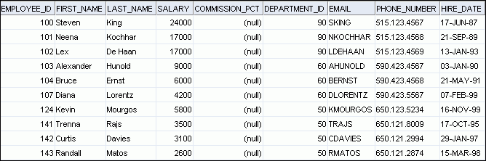
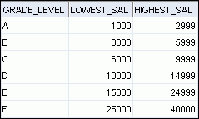
Tables Used in the Course
EMPLOYEES
DEPARTMENTS
JOB_GRADES
Notes:
Oracle Database 11g: SQL Fundamentals I I - <number>
Tables Used in the Course
The following main tables are used in this course:
EMPLOYEES table: Gives details of all the employees
DEPARTMENTS table: Gives details of all the departments
JOB_GRADES table: Gives details of salaries for various grades
Apart from these tables, you will also use the other tables listed in the previous slide such as the LOCATIONS and the JOB_HISTORY table.
Note: The structure and data for all the tables are provided in Appendix B.

Slide 32
Lesson Agenda
  Course objectives, course agenda, and appendixes used in this course
  Overview of Oracle Database 11g and related products
  Overview of relational database management concepts and terminologies
  Introduction to SQL and its development environments
  The HR schema and the tables used in this course
  Oracle Database 11g documentation and additional resources
Notes:
Oracle Database 11g: SQL Fundamentals I I - <number>

Slide 33
Oracle Database 11g Documentation
  Oracle Database New Features Guide 11g,
  Release 1 (11.1)
  Oracle Database Reference 11g, Release 1 (11.1)
  Oracle Database SQL Language Reference 11g,
  Release 1 (11.1)
  Oracle Database Concepts 11g, Release 1 (11.1)
  Oracle Database SQL Developer User's Guide,
  Release 1.2
Notes:
Oracle Database 11g: SQL Fundamentals I I - <number>
Oracle Database 11g Documentation
Navigate to http://www.oracle.com/pls/db111/homepage to access the Oracle Database 11g documentation library.

Slide 34
Additional Resources
For additional information about the Oracle Database 11g, refer to the following:
  Oracle Database 11g: New Features eStudies
  Oracle by Example series (OBE): Oracle Database 11g
    http://www.oracle.com/technology/obe/11gr1_db/index.htm
Notes:
Oracle Database 11g: SQL Fundamentals I I - <number>

Slide 35
Summary
  In this lesson, you should have learned that:
  Oracle Database 11g extends:
    The benefits of infrastructure grids
    The existing information management capabilities
    The capabilities to use the major application development environments such as PL/SQL, Java/JDBC, .NET, XML, and so on
  The database is based on ORDBMS
  Relational databases are composed of relations, managed by relational operations, and governed by data integrity constraints
  With the Oracle server, you can store and manage information by using SQL
Notes:
Oracle Database 11g: SQL Fundamentals I I - <number>
Summary
Relational database management systems are composed of objects or relations. They are managed by operations and governed by data integrity constraints.
Oracle Corporation produces products and services to meet your RDBMS needs. The main products are the following:
Oracle Database 11g with which you store and manage information by using SQL
Oracle Fusion Middleware with which you develop, deploy, and manage modular business services that can be integrated and reused
Oracle Enterprise Manager Grid Control 10g, which you use to manage and automate administrative tasks across sets of systems in a grid environment
SQL
The Oracle server supports ANSI-standard SQL and contains extensions. SQL is the language that is used to communicate with the server to access, manipulate, and control data.

Slide 36
Practice I: Overview
This practice covers the following topics:
  Running the Oracle SQL Developer demo
  Starting Oracle SQL Developer, creating a new database connection, and browsing the HR tables
Notes:
Oracle Database 11g: SQL Fundamentals I I - <number>
Practice I: Overview
In this practice, you perform the following:
Run through the Oracle SQL Developer demo.
Use Oracle SQL Developer to examine data objects in the ORA account assigned to you. The ORA accounts contain the HR schema tables.
Note the following location for the lab files:
D:\labs\SQL1\labs
If you are asked to save any lab files, save them in this location.
In any practice, there maybe exercises that are prefaced with the phrases “If you have time” or “If you want an extra challenge.” Work on these exercises only if you have completed all other exercises within the allocated time and would like a further challenge to your skills.
Perform the practices slowly and precisely. You can experiment with saving and running command files. If you have any questions at any time, ask your instructor.
Note: All written practices use Oracle SQL Developer as the development environment. Although it is recommended that you use Oracle SQL Developer, you can also use SQL*Plus that is available in this course.

Slide 37
Notes:
Oracle Database 11g: SQL Fundamentals I I - <number>
Practice I
This is the first of many practices in this course. The solutions (if you require them) can be found in Appendix A. Practices are intended to cover most of the topics that are presented in the corresponding lesson.
Run Through the Oracle SQL Developer Demo: Creating a Database Connection
1. Access the demo “Creating a database connection” at:
http://st-curriculum.oracle.com/tutorial/SQLDeveloper/html/module2/mod02_cp_newdbconn.htm
Starting Oracle SQL Developer
2. Start Oracle SQL Developer using the sqldeveloper desktop icon.
Note: When you start SQL Developer for the first time, you need to provide the path to the java.exe file. This is already done for you as a part of the classroom setup. In any case, if you are prompted, enter the following path: D:\app\Administrator\product\11.1.0\client_1\jdevstudio\jdk\bin
Creating a New Oracle SQL Developer Database Connection
3. To create a new database connection, in the Connections Navigator, right-click Connections. Select New Connection from the menu. The New/Select Database Connection dialog box appears.
4. Create a database connection using the following information:
a. Connection Name: myconnection.
b. Username: oraxx where xx is the number of your PC (Ask your instructor to assign you one ora account out of the ora1-ora20 range of accounts.).
c. Password: oraxx
d. Hostname: Enter the host name of the machine where your database server is running.
e. Port: 1521
f. SID: ORCL
g. Ensure that you select the Save Password check box.

Slide 38
Notes:
Oracle Database 11g: SQL Fundamentals I I - <number>
Practice I (continued)
Testing and Connecting Using the Oracle SQL Developer Database Connection
5. Test the new connection.
6. If the status is Success, connect to the database using this new connection.
Browsing the Tables in the Connections Navigator
7. In the Connections Navigator, view the objects available to you in the Tables node. Verify that the following tables are present:
COUNTRIES
DEPARTMENTS
EMPLOYEES
JOB_GRADES
JOB_HISTORY
JOBS
LOCATIONS
REGIONS
8. Browse the structure of the EMPLOYEES table.
9. View the data of the DEPARTMENTS table.
Opening a SQL Worksheet
Open a new SQL Worksheet. Examine the shortcut icons available for the SQL Worksheet.

